Slide 1

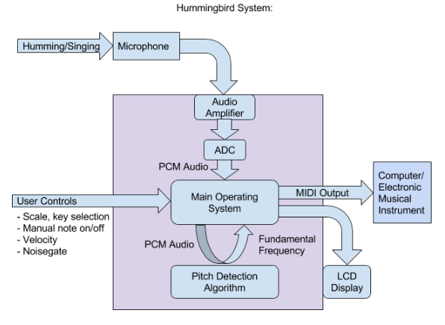
Hummingbird: Acoustic Control for Electronic Musical Instruments
Joey Devoto, Marcus Gronberg, Andre Marquez, Jason Vance
Abstract
Overview
Analysis
Hummingbird is a musical instrument unlike any other. It is easy enough for an unskilled beginner, and powerful enough for the most expert musicians. Hummingbird is the instrument that you play by humming your voice. When you hum into the device, real time algorithms process the wavelengths of your voice to determine which note you are hitting. Hummingbird is designed for experimenting with new melodies and composing masterpieces. The system captures audio using a microphone, identifies the proper note, and outputs the note in MIDI, a signal receivable by modern keyboards and composing software such as Garage Band.
Algorithm Selection:
Note Snapping and Hysterysis:
Output from the PDA is fed into a “note snapping” function in which pitches are restricted to a predetermined set of frequencies – i.e. musical scales. Currently, the Hummingbird system is capable of processing music for the Chromatic, Major, Minor, Major Pentatonic, Minor Pentatonic, Blues, and Whole Tone scales.
Microphone data is sampled in real time, and temporarily written into one of two buffers, which we call data frames. Data frames have a length of 256 samples, and each sample has a resolution of 12 bits. The idea of having two data frames is so that one is readily available to be processed, while the other is being “filled” with new samples.
To extract the musical information from this audio, we implement a pitch detection algorithm to find the fundamental frequency of each frame. This fundamental frequency (which is a single numeric data value) is passed back to the main program, which translates the frequency into its associated musical note (A, B#, G, etc). This note can be placed into a MIDI message, which is sent out of the system to an electronic instrument or computer with digital music software.
 | Pros | Cons
FFT | Accurate Hz detection | Very slow (~200ms lag) Algorithm of O(n^2)
Zero Crossing | Very fast | Inaccurate Hz detection Has trouble picking up the lower 20% of notes
Auto Correlation | Accurate
Approach
Platform(PSOC)
Pitch Detection Algorithm (PDA):
The PDA is the “heart” of the project, so this is where a lot of time was spent researching, testing, and refining. Our main goals for the algorithm were simple: accurate and fast. FFT (fast Fourier transform), YAAPT (Yet Another Algorithm for Pitch Tracking), zero-crossing, and autocorrelation. Ultimately, we chose to implement our design using autocorrelation method as it proved to be the best balance between pitch accuracy and processing time.
Audio Acquisition:
-Microphone Amplifier Circuit:
The signal from the mic is fed into an analog amplification circuit before it is captured by the PSOC ADC. The circuit amplifies the signal to a range of -2[V] - 2[V], this allows the PSOC ADC to read the largest signal possible, which produces a clear digital signal.
- Analog to Digital Conversion:
ADC of the amplified microphone input is done using the onboard successive approximation ADC, which provides a faster sampling rate than that of the delta-sigma ADC - at the slight expense of bit resolution. In this real time application, faster sampling rate is more critical than bit resolution, especially because Hummingbird doesn’t record audio, it only interprets the signal and then throws it away
Results
24-30 pt Font only
Conclusion
Acknowledgments
24-30 pt Font only
We would like to credit the completion of this project to our one true god – the BASED GOD known as Lil B. Homeboy done fucked my bitch.
Logos of other financial assistance can go here as well (if logo exist)

